Slide 1
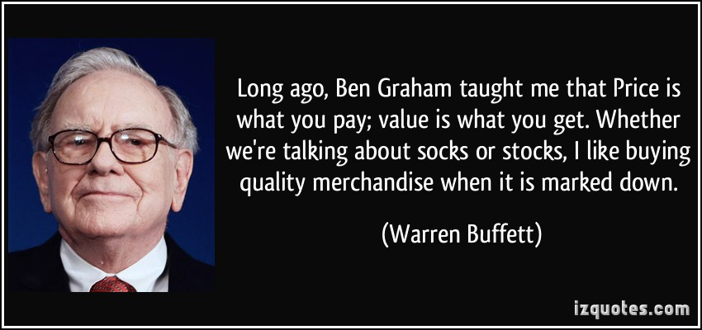
Using Machine Learning to determine key factors for Value Investing.
Samuel Appiah, Rajesh Paul, Prasanth Duvvur
This Photo by Unknown Author is licensed under CC BY

Slide 2
Motivation
Find value investing criteria that influence positive stock returns.
Get experience using machine learning algorithms, decision tree, random forest, neural networks, linear regression, stock data, financial charts and other technologies that we covered in class.
Validate hypothesis
Notes:
Consider talking about:
Performance of value strategies
Performance of value investors

Slide 3

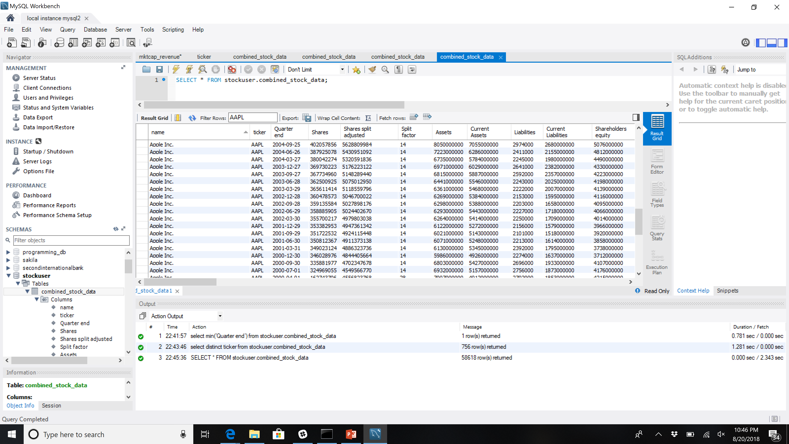
Data collection
Stock data from 1993-2018 – stockpup.com Core US Fundamentals Data, scrape website using python, pandas
Load data into MySQL – 756 stocks
Calculate stock returns, per quarter, per year, two year, three year, five year...
Get company name, ticker symbols from Yahoo!.
Notes:
Consider talking about:
Performance of value strategies
Performance of value investors

Slide 4
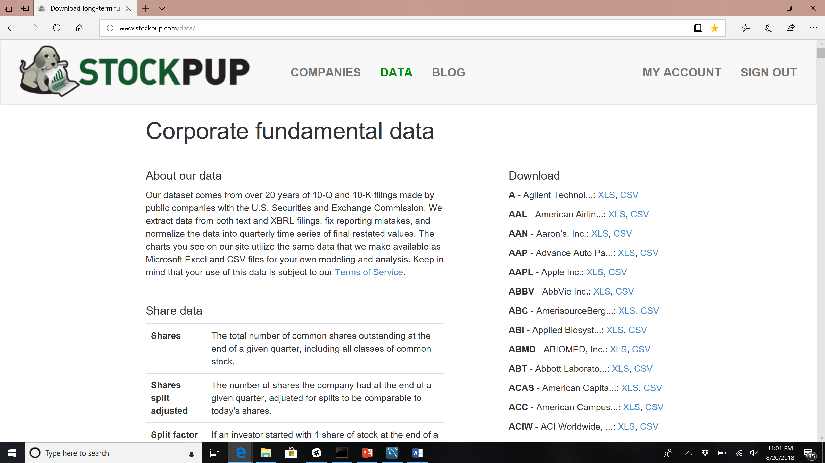
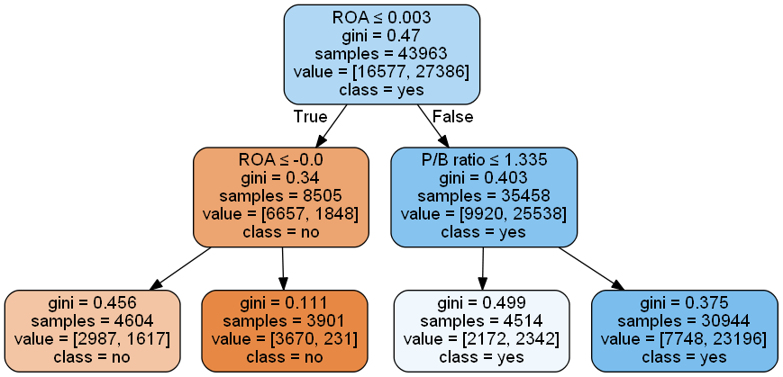
High Level System Design
Machine Learning module
DB
Models
Data Visualization
Data ETL (Python/Pandas)

Slide 5
Machine Learning – choosing a model

Slide 6
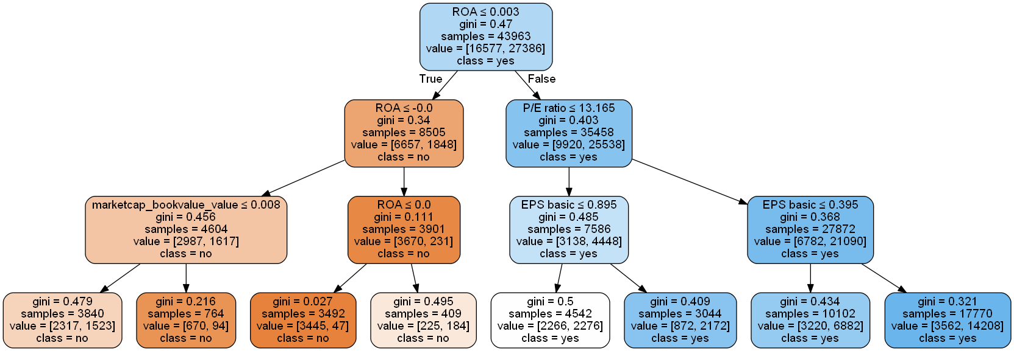
Decision Tree Analysis

Slide 7
Random Forest Analysis
Feature | Qtr | 1 year | 3 year | 5 year
Score test data | 0.660798 | 0.766086 | 0.79167 | 0.77659
P/B ratio | 0.111176 | 0.103744 | 0.095343 | 0.091823
EPS basic | 0.097725 | 0.091190 | 0.080681 | 0.083922
Free cash flow per share | 0.094145 | 0.075749 | 0.068647 | 0.079884
P/E ratio | 0.093520 | 0.124377 | 0.124205 | 0.110018
Equity to assets ratio | 0.0929425 | 0.081929 | 0.07339 | 0.079369
ROA | 0.0905495 | 0.113523 | 0.16460 | 0.147120
ROE | 0.0849126 | 0.107970 | 0.102764 | 0.098970
Current ratio | 0.0840162 | 0.07347 | 0.070200
Long-term debt to equity ratio | 0.0780208 | 0.068737 | 0.063495
cash_oper_gt_earnings_value | 0.0652397 | 0.053291
Dividend payout ratio | 0.0613678 | 0.062218 | 0.065663
mktcap_cash_value | 0.0222126 | 0.02017
mktcap_revenue_value | 0.0132831 | 0.011582
marketcap_bookvalue_value | 0.0079633 | 0.009686
mktcap_free_cash_flow_value | 0.0018081 | 0.001645
entvalue_earnings_value | 0.0011156 | 0.000702

Slide 8
Neural Networks Analysis

Slide 9
Deep Model Analysis

Slide 10
Univariate Linear Regression Analysis

Slide 11
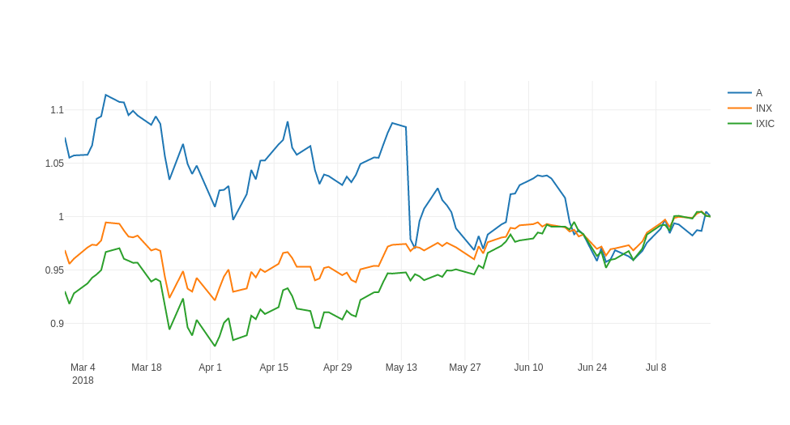
Dashboard – Stock trading plot
Provide user with current trading information and comparisons
Alphavantage API call
Timeseries daily API
100 days of history
Notes:
Consider talking about:
Performance of value strategies
Performance of value investors

Slide 12
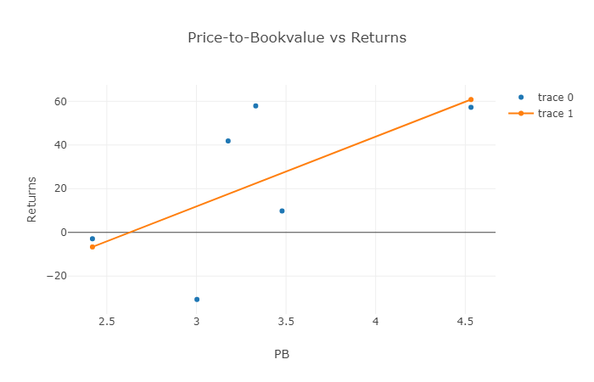
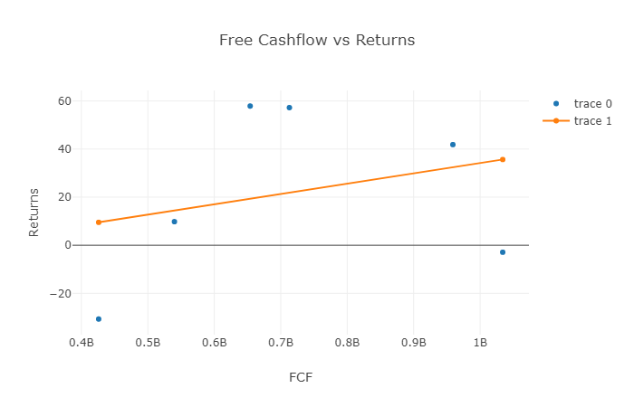
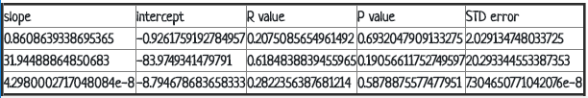
Dashboard – Analysis plots
Charts and data to do stock analysis
Charts to compare fundamentals to returns
Table summarizes statistical analysis performed
Notes:
Consider talking about:
Performance of value strategies
Performance of value investors

Slide 13
Findings/Conclusions
The top 5 factors for determining stock value per our analysis (decision tree) are ROA, PE, EPS, PB, ROE.
The best accuracy for the models is 3 years, meaning the predictions are most valid for an investment period of 3 years.
The models are at best only a guide to select the stocks and the factors. With the best accuracy of , there are obviously other factors at play and we need to study each of the suggested stocks (or others) before making a decision.
Notes:
Consider talking about:
Performance of value strategies
Performance of value investors

Slide 14
Future
Analyze more stock performance criteria
Utilize machine learning algos to find value stocks.
More sophisticated predictive analysis and modeling
Make money
Notes:
Consider talking about:
Performance of value strategies
Performance of value investors

